Slide 1
Overview
Chapter 1

Slide 2
Objectives
What are data structures and algorithms?
What good will it do me to know about them?
When does it make sense to apply what I learn here?

Slide 3
Data Structure and Algorithms
A data structure is an arrangement of data in a computer’s memory. Data structures include arrays, linked lists, stacks, binary trees, and hash tables, among others.
Algorithms manipulate the data in these structures in various ways, such as searching for a particular data item and sorting the data.

Slide 4
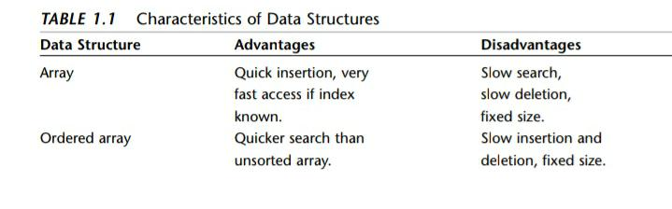
Overview of Data Structures
Table 1.1 shows the advantages and disadvantages of the various data structures.
malthidar

Slide 5
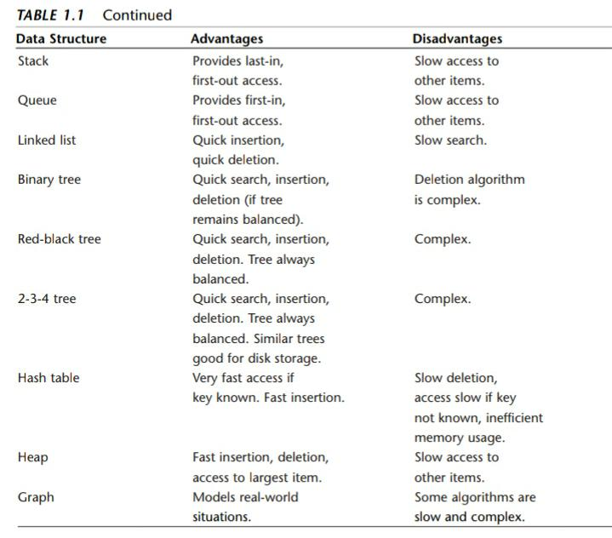
Overview of Data Structures

Slide 6
Overview of Algorithms
Insert a new data item.
Search for a specified item.
Delete a specified item

Slide 7
Some Definitions
Database to refer to all the data that will be dealt with in a particular situation. Each item in a database has a similar format.
Records are the units into which a database is divided. They provide a format for storing information. A record often represents a real-world object, such as an employee or a car part.
Field: A record is usually divided into several fields. A field holds a particular kind of data.
Key: A key is a field in a record that’s used to carry out some operation on the data. A database can be searched for all records whose key field has a certain value.

Slide 8
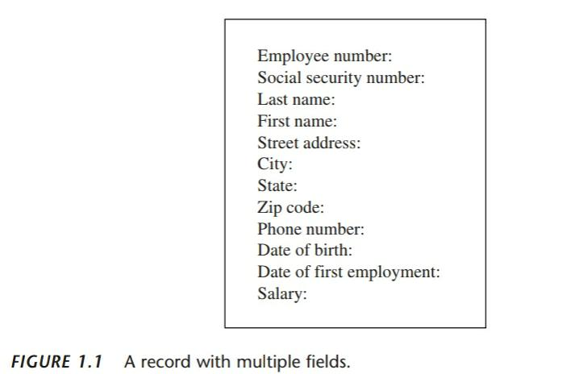

Slide 9
Object-Oriented Programming
Objects contain both methods and fields (data).
A class is a specification for any number of objects.
To create an object, you use the keyword new in conjunction with the class name.
To invoke a method for a particular object, you use the dot operator.

Slide 10
Object-Oriented Programming
A constructor, which is a special method that’s called automatically whenever a new object is created.
Public and Private keywords are access modifiers and determine which methods can access a method or field.
Data fields in a class are typically made private and methods are made public. This protects the data; it can’t be accidentally modified by methods of other classes.
Inheritance is the creation of one class, called the extended or derived class, from another class called the base class. The extended class has all the features of the bas class, plus some additional features.
Polymorphism involves treating objects of different classes in the same way. For polymorphism to work, these different classes must be derived from the same base classes.

Slide 11
Java Library Data Structures
The java.util package contains data structures, such as Vector (an extensible array), Stack, Dictionary, and Hashtable.
import java.util.*;

Slide 12
Reference
Data Structures and Algorithms in Java, Second Edition
Copyright © 2003 by Sams Publishing

